Slide 2
OOP – Object-Oriented Programming Principle is the strategy or style of developing applications based on objects. Anything in the world can be defined as an object. And in the OOPs, it can be defined in terms of its properties and behavior.
For Example – Consider a Television, It is an object. And the properties related to it are. It’s With and Height, color, type (SmartTV or CRT TV), etc. And the behavior can be – we can change the channel, Adjust volumes and settings, switch off, switch on, etc are lots of behavior are there. The operation on the behavior will affect the properties. Changing the channel will affect its property.
So, similar things happen in Object-Oriented programming also, that each object has some properties and behavior associated with it, that are defined in the class.

Slide 3
How Software is Developed in Object-Oriented Programming?
We say that in OOPs, there is an engineered approach is followed for the development of software. Like first designing a blueprint that contains the functionality of the object, operations of an object, etc. And then based on the blueprint, the object is created that implements the blueprint into existence. It is just like the other engineering things which are followed. For example – The construction of any building includes steps like – Planning, Designing a blueprint, Finalizing a blueprint, after a blueprint is finalized then start construction of it.
The same is followed in Object-oriented Programming using the concept of classes and objects, which are the pillars of it.
In OOPs, the work can be distributed between developers easily, and also the work can be reused between programmers.

Slide 4
Objects – Object is the entity that makes the classes to be implemented into the program. It makes the features, properties, and behaviors of the class to be implemented. Example – A car is an object that has property color, model, brand name, fuel type, etc, and behaviors like, it runs. So these properties and behavior make an object (CAR).
Classes – A class can be stated as the blueprint of the object. This states what an object can do. It contains all the features, attributes, and behavior of what the model can do. We can say that class contains the definition of the object. Example – Car color, engine type, etc. And with the definition, we can create any number of objects.
Methods – Methods are the attributes of the class which are defined for the specified behavior of the object. It can also modify the state of the class. Example – Method to drive a car, It changes the state of the car from parking state to running state.
Instances – It is the members of the class who holds some values related to the objects of the class.

Slide 5
To understand better about these components better, let’s consider an example – Consider the same example of television. So according to the Object-Oriented Programming approach, you will perform certain steps-
Define object name as a Television.
Define the properties of television like channel, volume, on and off, etc.
Create a function that will handle the functionality of tree-like changing the channel adjusting volume, or other things.
Now implement all features into a program.
Now when you define an object as Television then it is the class. And then you declare the properties of that Television -like channel, volume, etc is the instances of the class Television. You create functions to change the properties, which are the methods of Television. And finally when you implement this in your program then you will create an object of class Televisionto implement into the program.

Slide 6
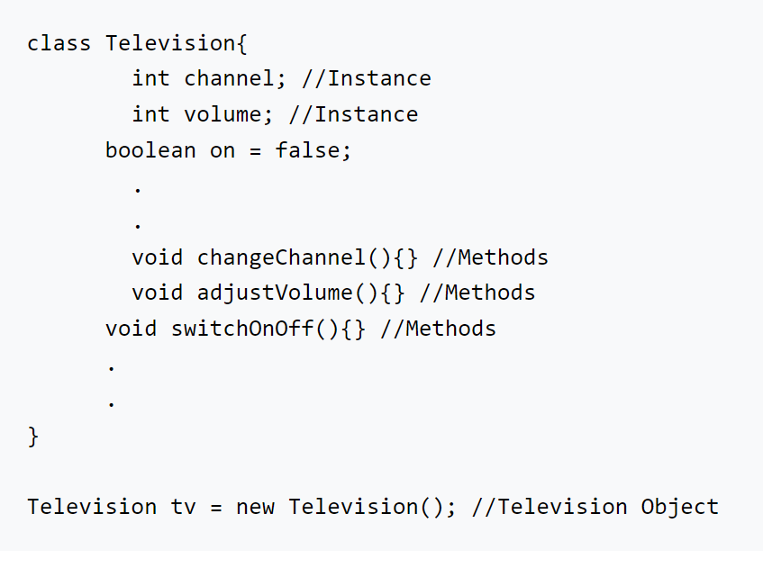

Slide 7
Explanation – In the above code. Defined Television is a class that contains the instances that are the property of the class. And methods that help to change the behavior of the television class. And we are creating one object of television called tv, which will have all the properties and behavior of the class.

Slide 8
Principles of Object-Oriented Programming
Object-Oriented Principles mainly include the 4 pillars that together make the OOP a very powerful concept. That is –
Abstraction
Encapsulation
Inheritance
Polymorphism

Slide 9
OOP is based on real-life engineered things. Like the approaches followed in the other engineering – Electronic Engineers are making some device, Automobile engineers are making some vehicle, etc. So the design approaches followed their, the same replicated to the software engineering with the concept of these 4 Object-Oriented Programming principles.
If we analyze the programming concept then we will find that there are two elements of programming –
Data
Operations on Data [functions]

Slide 10
So If we develop software then that software is meant for performing tasks on data only.
And if any function is performed on data, then there might be chances that in the future also the same operation can be performed either in the same way or in some modified way.
So that is very smoothly done using the concept of OOP principles. Let’s see the principles:

Slide 11
Abstraction
Abstraction can be defined as hiding internal implementation and showing only the required features or set of services that are offered.
This is the most essential part of Object-Oriented programming.

Slide 12
Example 1 – We all have been using ATMs. And if we want to withdraw the money from that then we simply interact with the Use Interface Screen where we have been asking for details. As a user, we only want that I can use that ATM for the services. We are not interested in knowing the internal implementation that what is the process happening inside the ATM Machine like getting card details, validation, etc kind of things. We only have been provided an interface to interact with that and simply ask for the work. And the internal implementation we don’t need to know. So that is the Abstraction.
Explanation-
The above image shows the GUI screen of the ATM. In this when we want to withdraw then we simply use that. For the implementation part, we don’t care.

Slide 13
Features of Abstraction –
Security- With Abstraction, the Outside persons don’t know the internal implementation so it makes the classes more secure, so the unauthorized user will not have access to the data.
Easy Enhancement- Suppose in the future we want to change the logic of the implementation in class, So we don’t have to change the entire external logic which is there for the user. Just we need to make changes for the methods and it will not affect the functionality.
Improves Easiness- It helps to use the features without knowing implementation so it improves easiness for the users to use that.
Maintainability will improve- Without affecting the user, it can able to perform any types of changes internally. SO maintainability will improve.

Slide 14
Encapsulation
Encapsulation can be defined as the binding of data and attributes or methods and data members in a single unit. In classes, we have Data and attributes that perform operations on that data.
So according to the OOPs principle of Encapsulation, that data can be merged into a single unit. Encapsulation enhances more security of the data as everything related to a single task must be grouped and access to the data is given as per need.
And this can be achieved using the concept of Data Hiding.
Encapsulation = Data Hiding + Abstraction.

Slide 15
Data Hiding – It means hiding the data of the class and restricting access to the outside world. Example – Using the access specifier keywords like private that restricts the data to only accessible and modifiable in the same class. Outside users can not access the data.
Let’s understand with the help of an example-

Slide 16
Example 1- In the market, Capsules are available to cure different medical problems. Consider capsule for fever. Now in that capsules, there are different compositions are grouped to make a complete medicine that cures fever.
So the grouping of that compositions into a single unit in the capsule is a form of encapsulation. Here, consider fever as data, and the capsule as the operations on the data.
So everything is grouped here.

Slide 17
Example 2- In a car, we have all the required things to make a car complete. Like engines, gear shift, Wheels, etc, and these are grouped into a single body that makes a car.
It is not like the wheels are not attached to the car, Engines are misplaced and dragged outside, etc.
Everything is grouped into a single body.
So in the OOP Principle also the same principle applies that whatever operations are there for a particular group, must be capsuled to a single unit.

Slide 18
Features of Encapsulation –
It provides extra security by the concept of Data Hiding.
It groups the data and operation in that data into a single unit.
It attaches an extra security layer to the data and allows to access data only to authorized ones.

Slide 19
Inheritance
Inheritance is the method of acquiring features of the existing class into the new class.
Suppose there is a class, considered as the parent class, that has some methods associated with it. And we declare a new class, considered as the child class, that has its own methods.
So, when a child class is inherited from the parent class then it will have all the methods associated with parent class are available in the child class along with the child class own methods also.
So that is Inheritance.

Slide 20
Example 1
We all have seen the updates which receive on gadgets both in terms of hardware and software.
Like firstly mobile phones are their only to talk and then used for media access, Internet, Camera, etc.
So these are evolution that arrives by adding some extra feature and making a new product without rebuilding the complete functionality so it is an example of inheritance.
Similarly, in software, regular updates are with some new features are also the inheritance.

Slide 21
Object is an instance of a class in a particular moment in runtime that can have its own state and data values. Likewise a static UML(Unified Modeling Language)object diagram is an instance of a class diagram; it shows a snapshot of the detailed state of a system at a point in time, thus an object diagram encompasses objects and their relationships which may be considered a special case of a class diagram or a communication diagram.

Slide 22
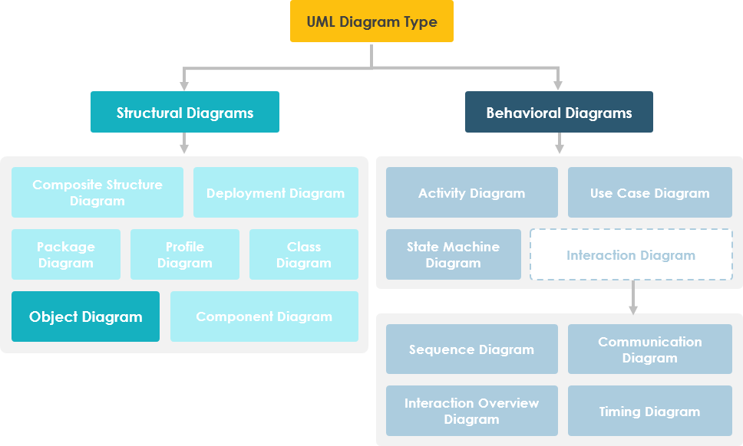

Slide 23
Purpose of Object Diagram
The use of object diagrams is fairly limited, mainly to show examples of data structures.
During the analysis phase of a project, you might create a class diagram to describe the structure of a system and then create a set of object diagrams as test cases to verify the accuracy and completeness of the class diagram.
Before you create a class diagram, you might create an object diagram to discover facts about specific model elements and their links, or to illustrate specific examples of the classifiers that are required.

Slide 24
Basic Object Diagram Symbols and Notations
Object Names:Every object is actually symbolized like a rectangle, that offers the name from the object and its class underlined as well as divided with a colon.
Object Attributes:Similar to classes, you are able to list object attributes inside a separate compartment. However, unlike classes, object attributes should have values assigned for them.
Links:Links tend to be instances associated with associations. You can draw a link while using the lines utilized in class diagrams.

Slide 25
https://www.interviewbit.com/blog/principles-of-oops/

